Slide 1
PROC UNIVARIATE
SMU MSDS 6306
5/23/17
Jack K. Rasmus-Vorrath | Mohan Nepal

Slide 2
Summarize, explore, and Model Distributions
OVERVIEW:
Use tables and graphical displays (such as histograms and nonparametric density estimates) to find key features of distributions, identify outliers and extreme observations, determine the need for data transformations, and compare distributions.
Produce descriptive and comparative statistics and graphics
Assess goodness of fit with hypothesis tests and graphical displays (probability plots, QQ plots).
Validate distributional assumptions
Perform nonparametric tests and compute robust estimates of location and scale.
IN PARTICULAR:

Slide 3
COMMON OPTIONS AND STATEMENTS
<OPTIONS> |  | <STATEMENTS>
OPTION | Meaning | STATEMENT | Meaning
DATA= | DATA set to use for analysis | VAR variables(s); | Variable(s) to consider for analysis
ALPHA = p | Confidence level for the analysis | BY variables(s); | Data that need to be sorted first before performing analysis for each category
MUO = n | Value of location parameter t-test, signed test | CLASS variables(s); | Variables(s) to group the data when creating Histogram
PLOTS | Request various plot like stem-and-leaf, box, histogram, normal probability plot. | OUTPUT | Output dataset and statistics to include in the analysis
NOPRINT | Suppress the output of descriptive statistics. | HISTOGRAM | Produces Histogram for specified variables.

Slide 4
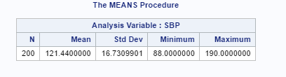
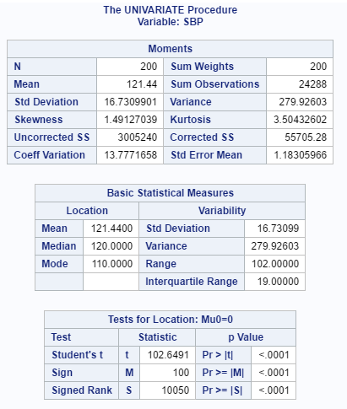
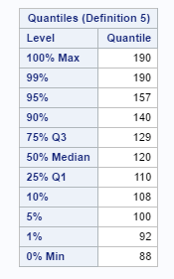
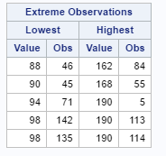
UNIVARIATE VS Means
PROC MEANS:
PROC MEANS DATA="/home/mohann0/MSDS6306-403/SASDATA/coronary";
VAR SBP;
RUN;
PROC UNIVARIATE:
Syntax:
PROC UNIVARIATE <Options>; <Statements>;
Example:
PROC MEANS DATA="/home/mohann0/MSDS6306-403/SASDATA/coronary";
VAR SBP;
RUN;

Slide 5
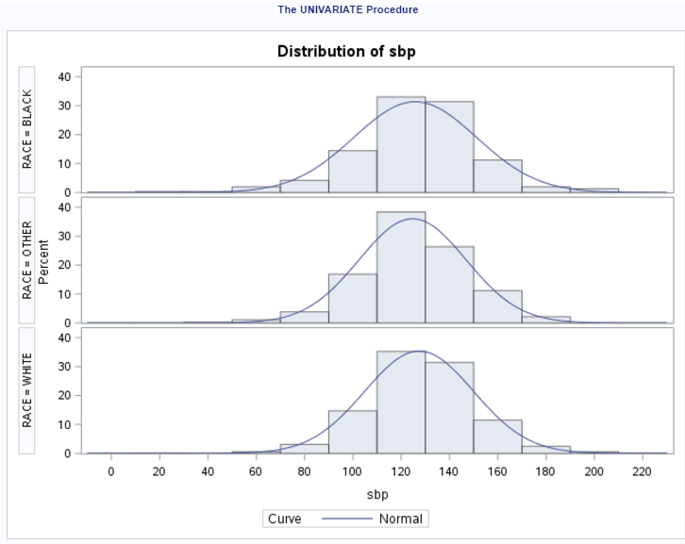
HISTOGRAM
PROC UNIVARIATE DATA="/home/mohann0/MSDS6306-403/SASDATA/WOUND" NOPRINT;
CLASS RACE_CAT;
LABEL RACE_CAT="RACE";
VAR SBP;
HISTOGRAM /NORMAL (COLOR=GREEN W=5) NROWS=3;
RUN;
TITLE;FOOTNOTE;

Slide 6
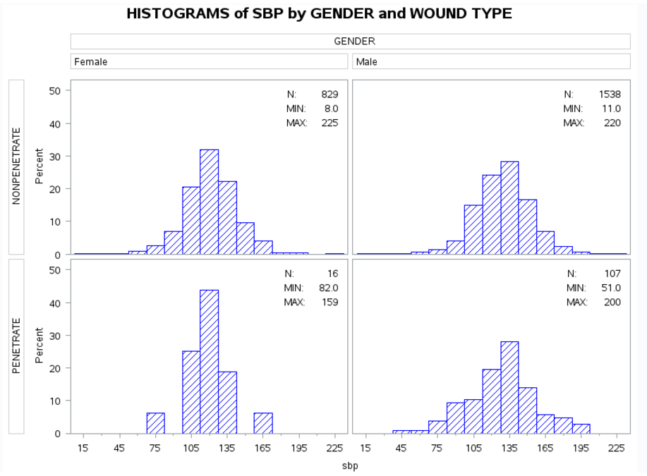
CLASS Statement
PROC FORMAT;
VALUE FMTWOUND 0="NONPENETRATE"
1="PENETRATE";
RUN;
TITLE 'HISTOGRAMS of SBP by GENDER and WOUND TYPE';
PROC UNIVARIATE DATA="/home/mohann0/MSDS6306-403/SASDATA/WOUND" NOPRINT;
CLASS WOUND GENDER;
VAR SBP;
HISTOGRAM / NROWS=2 NCOLS=2 CFILL=BLUE PFILL=M3N45;
INSET N='N:' (4.0) MIN='MIN:' (4.1) MAX='MAX:' (4.1)
/ NOFRAME POSITION=NE HEIGHT=2;
FORMAT WOUND FMTWOUND.;
RUN;

Slide 7
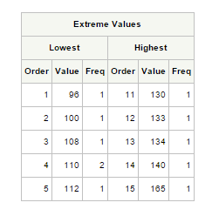
Identifying Extreme Observations and Values
Title ‘Extreme Blood Pressure Observations’;
Ods select ExtremeObs; #restricts output to ExtremeObs table
Proc univariate data = Bpressure nextrval = 5; #specifies number of extreme values shown at each table end
var Systolic Diastolic;
id PatientID;
Run;
FOR MORE: (Tables for Summary Statistics)
http://support.sas.com/documentation/cdl/en/procstat/63104/HTML/default/viewer.htm#procstat_univariate_sect050.htm

Slide 8
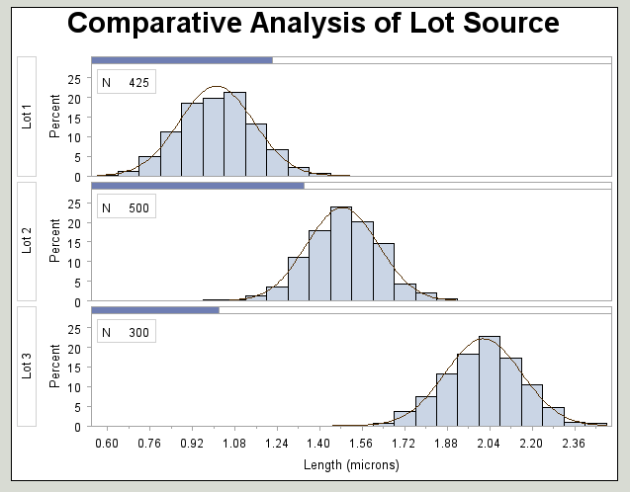
Fitted Normal Curves On Comparative Histograms
Title ‘Comparative Analysis of Lot Source’;
Proc univariate data = Channel noprint;
Class Lot;
Histogram Length / nrows = 3 intertile = 1 cprop normal(noprint); #cprop requests shaded bars above each tile
Inset n = “N” / pos = nw;
Run;
FOR MORE: (Lognormal, Weibull, Gamma Curves)
http://support.sas.com/documentation/cdl/en/procstat/63104/HTML/default/viewer.htm#procstat_univariate_sect077.htm

Slide 9
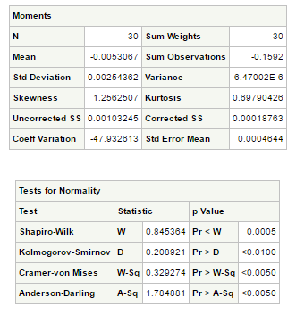
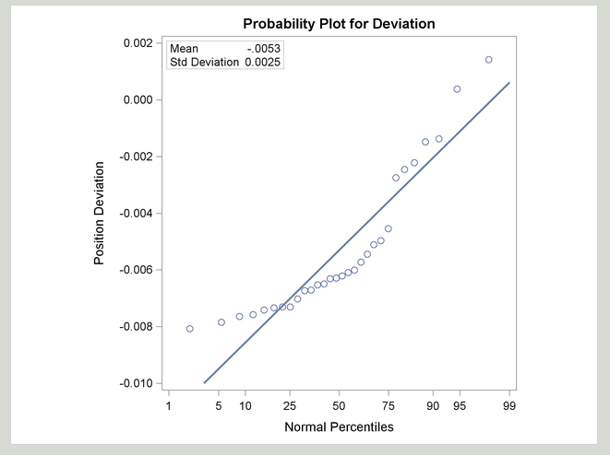
Modeling a data distribution
Title ‘Position Deviation Analysis’;
Ods graphics on;
Ods select Moments TestsForNormality ProbPlot; #produces selected ODS Graphics output
Proc univariate data = Aircraft normaltest; #requests tests for normality
var Deviation;
probplot Deviation / normal (mu = est sigma = est) square; #using parameter estimates from data
label Deviation = ‘Position Deviation’;
inset mean std / format = 6.4;
Run;
Ods graphics off;
FOR MORE: (Probability-Probability Plot)
http://support.sas.com/documentation/cdl/en/procstat/63104/HTML/default/viewer.htm#procstat_univariate_sect017.htm

Slide 10
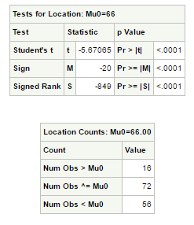
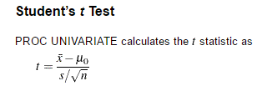
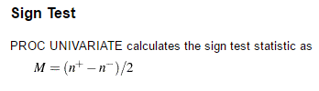
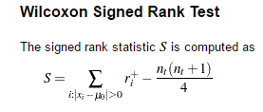
Testing for Location & Nonparametric tests
Title ‘Analysis of Female Height Data’;
Ods select TestForLocation LocationCounts;
Proc univariate data = Heights mu0 = 66 loccount; #sets H0 value and produces count table of applicable values
var Height;
Run;
FOR MORE: (Signed-Rank Test)
http://www.stat.purdue.edu/~tqin/system101/method/method_wilcoxon_signed_rank_sas.htm

